Slide 1
Level-1: (Rice)Crop Discovery Level-2: (Rice)Yield Prediction
Rajendra Kumar Vechalapu

Slide 2
Goals:
To predict the presence of rice crop at 250 geo locations (latitude and longitude) in the An Giang province of Vietnam using satellite data.
To predict the yield of rice crop for a given season at 100 geo locations (latitude and longitude) in the Chau Thanh, Thoai Son and Chau Phu regions of Vietnam using satellite data.
Datasets: Sentinel-1-RTC, Sentinel-2, Landsat and any public datasets.

Slide 3
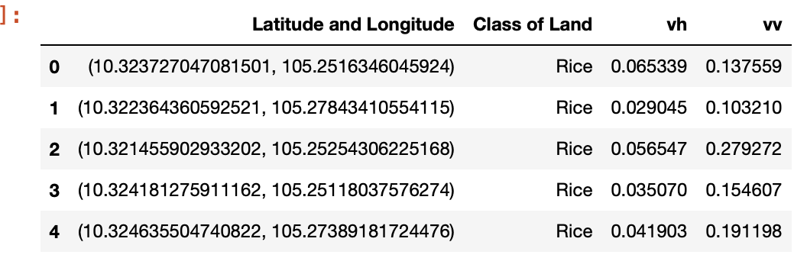
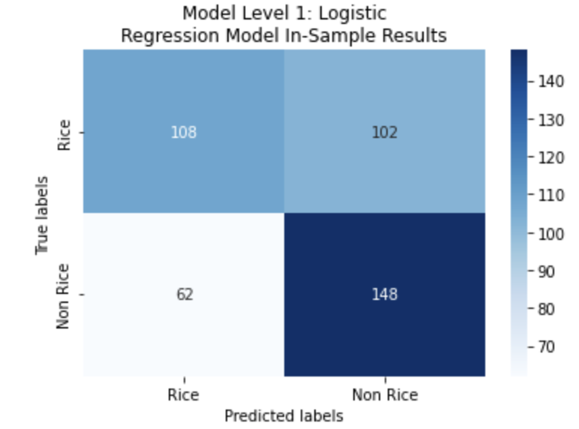
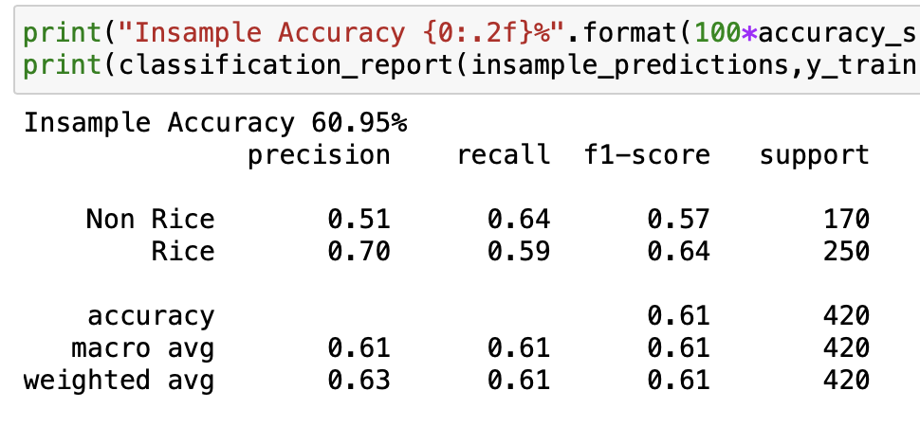
Traditional Supervised ML
Crop discovery: Logistic Regression --- vv, vh

Slide 4
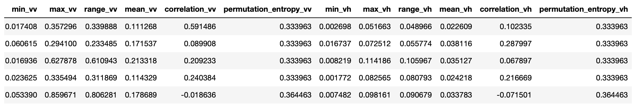


Traditional Supervised ML
Crop prediction: ExtraTreesRegressor --- vv, vh, vv/vh
Feature Engineering: Min, Max, Range, Mean, Correlation, Entropy

Slide 5
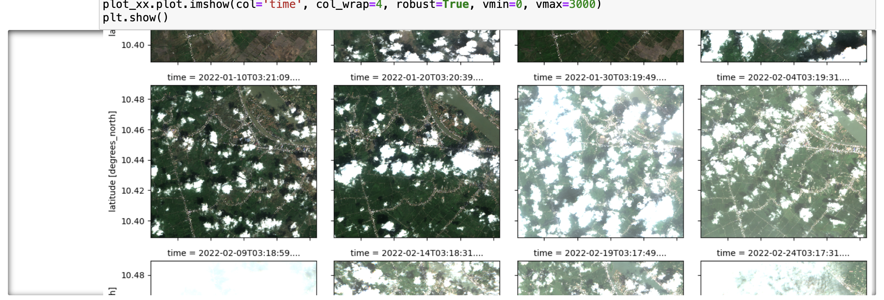
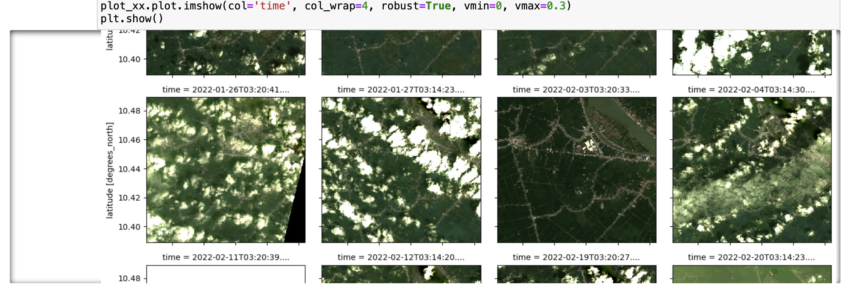
Satellite image data – Sentinel-1, Sentinel-2, Landsat

Slide 6
Change in approach…to DL?
Discussion

